Slide 1
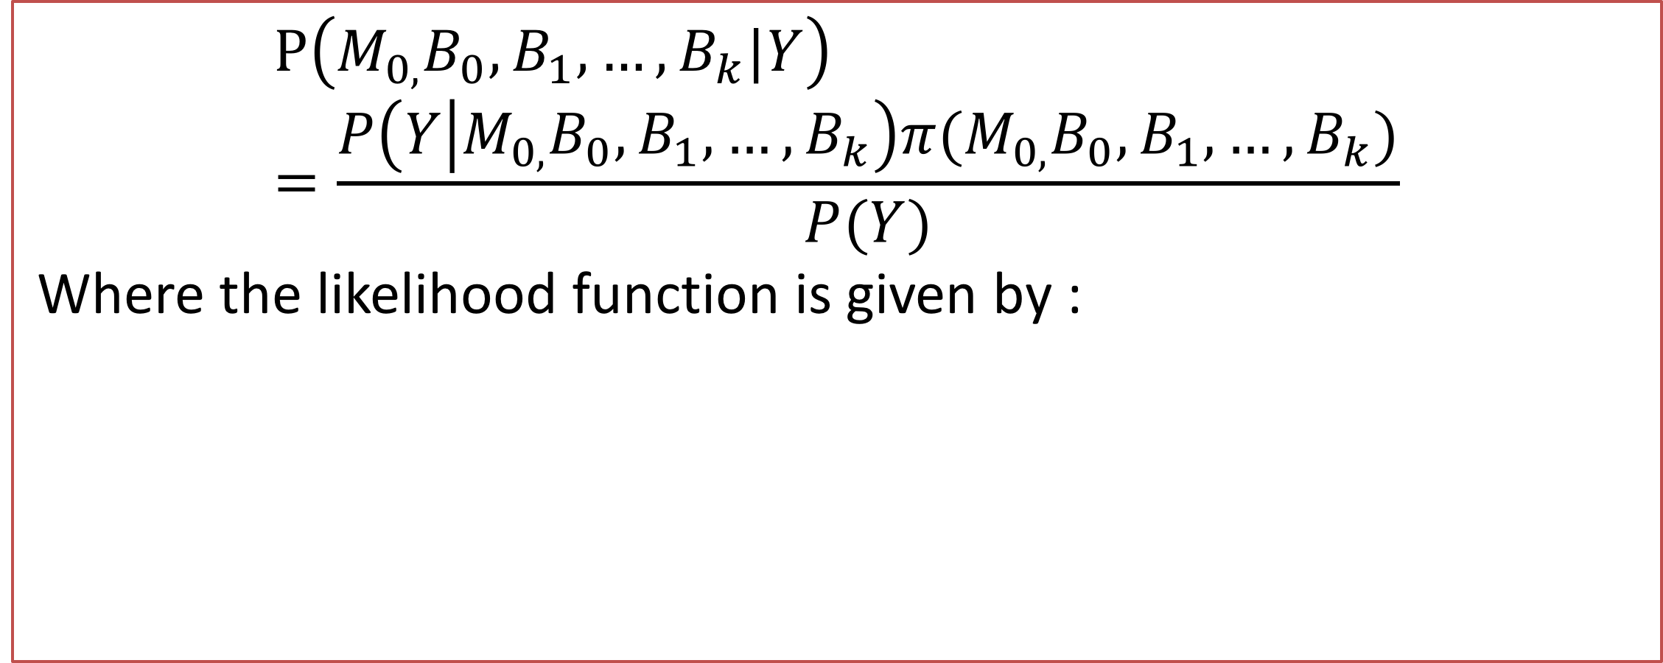
Heart Disease Data Meets Mathematics
Jeenn Barreiro and Eric Ruggieri
Department of Mathematics, College of the Holy Cross
What is Heart Disease?
Logistic Regression
Metropolis Hastings Algorithm
Heart disease is a very broad term that describes a range of conditions that affect the heart. These include: blood vessel diseases, such as coronary artery disease; heart rhythm problems (arrhythmias); and heart defects you're born with (congenital heart defects), among others. Heart Disease is also interchangeably used with cardiovascular disease. This other type of disease is generally referred to conditions that involve narrowed or blocked blood vessels that can lead to a heart attack, chest pain or stroke. Heart diseases form because of lifestyle choices. It is said heart disease is the most preventable type of disease out there, yet it is the number one killer of men and women in the United States.
The goal of logistic regression is to describe the relationship between the binary characteristic of interest, which in my case is heart disease, and a set of independent variable, which are the attributes in my dataset.
Evaluating all potential models is not practical, so we use the Metropolis-Hastings algorithm to explore the posterior space. Given the current model, proposals are generated by randomly selecting an attribute and either adding or deleting it from the current model. The proposed model is accepted with probability :
min{1,$\frac{P(proposed model\text{|}Y)}{P(current model\text{|}Y)}$}
where the posterior probability of each model is evaluated using Monte Carlo integration. The Metropolis-Hastings algorithm was run for 140,000 iterations with a burn-in of 10% and a lag of 3.
Odds = $(\frac{P}{1−P})$→ ($\frac{\text{Prob}\text{. }\text{of} \text{presence} \text{of} \text{characteristic}}{\text{Prob}\text{. }\text{of} \text{absence} \text{of} \text{characteristic}}$).
Logit(p)= ln(odds)= $B_{0} +B_{1}X_{1} + … +B_{k}X_{k}$
(p is the probability of presence of the characteristic of interest)
Solving for P…..
P= $\frac{e^{B_{0} +B_{1}X_{1} + … +B_{k}X_{k}}}{1+e^{B_{0} +B_{1}X_{1} + … +B_{k}X_{k}}}$
Baye’s Rule
General formula: $P\left(A|B\right)=\frac{P\left(B|A\right)∗P(A)}{P\left(B\right)}$
In context with this project: given the data, we want to find the measure of how well each potential model fits the data. In other words, which set of attributes can best predict the presence of heart disease?
Results
Data Set
Attribute
1 | 2 | 3a | 3b | 3c | 4 | 5 | 6 | 7
0 | 1 | 0 | 1 | 1 | 0 | 0 | 0 | 0
0 | 0 | 0 | 1 | 1 | 0 | 0 | 0 | 0
0 | 0 | 0 | 0 | 0 | 0 | 0 | 0 | 0
8 | 9 | 10 | 11 | 12 | 13a | 13b |  | Accuracy
0 | 1 | 0 | 1 | 1 | 0 | 1 |  | 84%
0 | 1 | 0 | 1 | 1 | 0 | 1 |  | 83%
0 | 0 | 0 | 1 | 1 | 0 | 1
The data used in this analysis was obtained from the University of California Irvine's Machine Learning Repository. Heart disease data was available for four different geographic locations, but we focused only on data from the Cleveland Clinic foundation. This data set contained the heart disease status of 303 individuals as well as data on fourteen different attributes, including:
Age of patient
Sex of patient
Whether or not a patient had a type of chest pain
Typical Angina
Atypical Angina
Non-Angina Pain
Resting blood pressure of the patient
Cholesterol level
Fasting blood sugar
Resting EKG
Max heart rate achieved during exercise
Exercise induced chest pain
ST depression induced by exercise relative to rest
The slope of the peak exercise ST segment
number of major vessels (0-3) colored by fluoroscopy
If individual had thalium defect or not
Thalium Fixed Defect
Thalium Reversible Defect
Showed up 50%
Showedup 70%
Showed up 80%
$$P\left(M_{0,}B_{0}, B_{1}, …, B_{k}|Y\right)=\frac{P\left(Y | M_{0,}B_{0}, B_{1}, …, B_{k}\right)π(M_{0,}B_{0}, B_{1}, …, B_{k})}{P(Y)}$$
Where the likelihood function is given by :
Attribute
Showed up 50%
Showedup 70%
Showed up 80%
Monte Carlo Integration
Conclusions/Future Work
Need to integrate out the regression parameters (β). Once we do Monte Carlo Integration, we have Marginal Posterior:
The work done was fairly accurate. The most accurate model was 84% correct and the least accurate model was 81% correct. Future work on this project will involve cross validation; this process will allow to pick all the data in a dataset and test certain groups as test data and training data. Then once each subgroup went through the analysis as a test and training data, an average of all the calculations is taken. This allows for even more accurate results.
Given a function f(x) from a to b, such as : F=$\int_{a}^{b}{f(x)}$ dx. Steps we use to integrate out the regression parameters:
1) Pick a random number between a to b, and call it $f(x_{i})$
2) Evaluate $x_{i}$
3) $\int{f(x_{i})}$ = $(b−a)∗(\frac{1}{N})∗(\sum{f(x_{i})})$
Acknowledgement
This work was supported by NSF grant DMS-1407670 (E. Ruggieri, PI) as a part of the Holy Cross Summer Research Program

